Slide 1

PDA - CHILE
06/06/2025

Slide 2
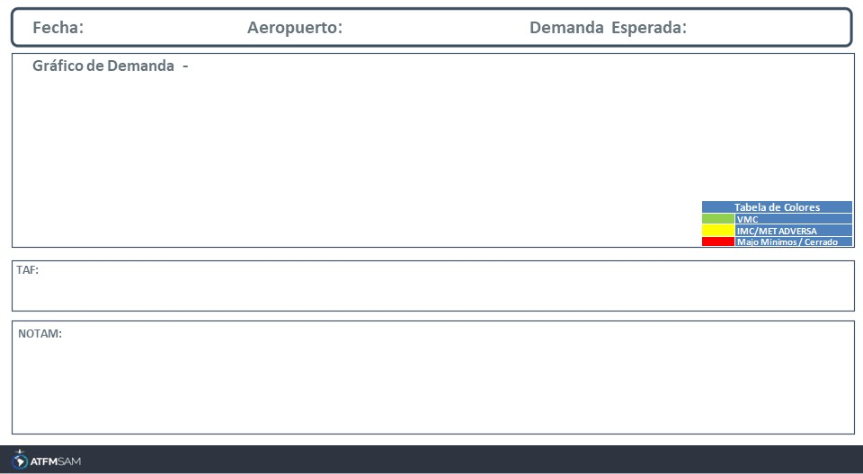
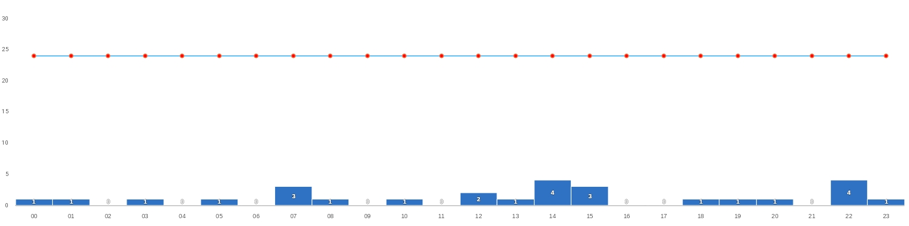
06/06/2025
SCDA
BAJA
Mañana | Tarde | Noche
TAF SCDA 051646Z 0518/0618 21016KT CAVOK TX19/0518Z TN16/0610Z BECMG 0521/0523 BKN020 BECMG 0600/0602 21006KT BECMG 0613/0615 FEW025 BECMG 0616/0618 21016KT

Slide 3
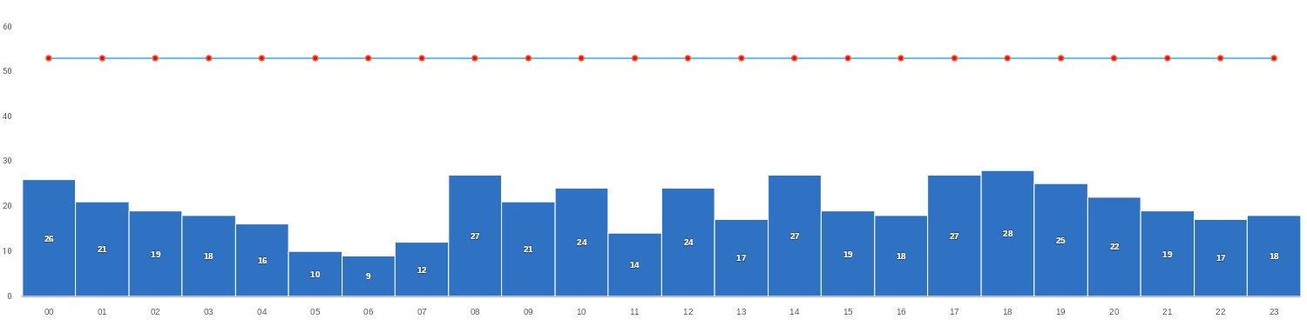
06/06/2025
SCEL
BAJA
Mañana | Tarde | Noche
TAF SCEL 051600Z 0518/0618 19010KT 7000 NSC TX20/0519Z TN02/0610Z BECMG 0600/0602 15005KT 5000 HZ BECMG 0602/0604 3000 BR BECMG 0605/0607 VRB02KT 2000 BR TEMPO 0609/0612 0800 FG VV002 BECMG 0615/0617 08005KT 4000 HZ

Slide 4
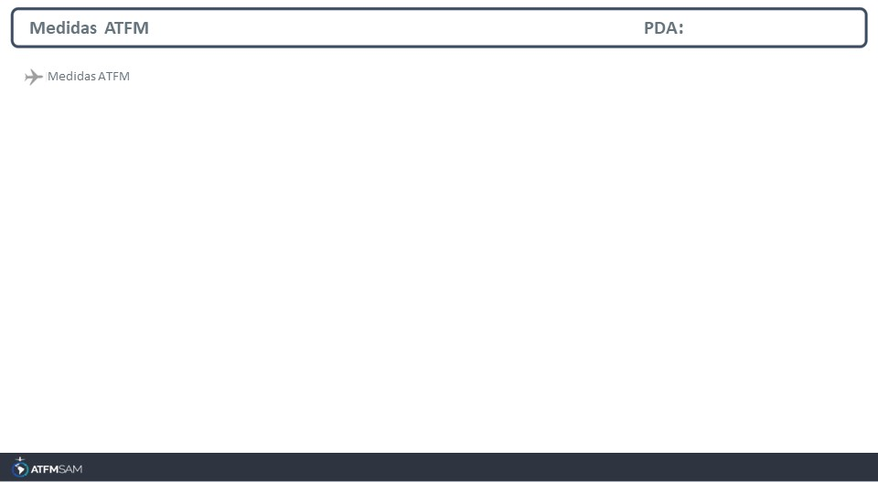
STATE | ORIGIN | DESTINY | ER | START | MEASURE | REASON

Slide 5
