Slide 1

PDA - CHILE
06/08/2024

Slide 2
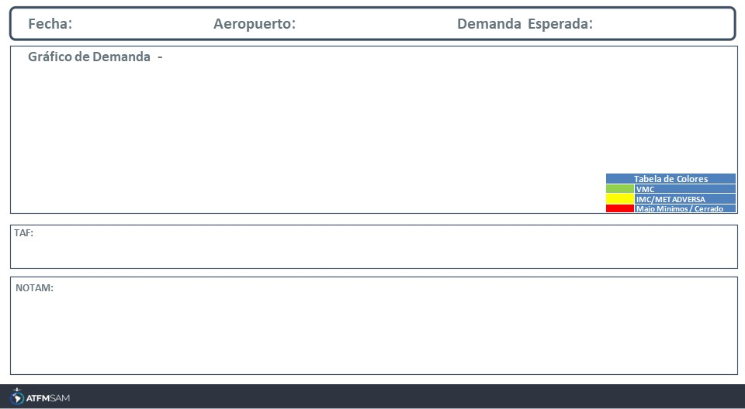
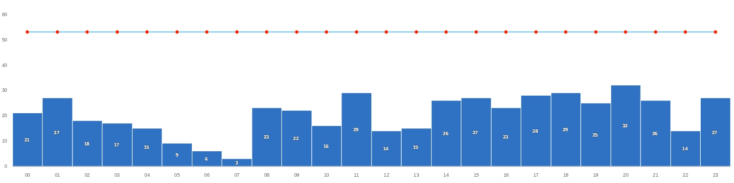
06/08/2024
SCEL
BAJA
Mañana | Tarde | Noche
TAF COR SCEL 051130Z 0512/0612 15004KT 9999 BKN100 BKN150 TX11/0519Z TN07/0610Z BECMG 0513/0515 03005KT 8000 -SHRA SCT050 BKN100 TEMPO 0516/0521 4000 RA FEW030 BKN050 OVC090 BECMG 0606/0608 3000 -RA BKN008 OVC020

Slide 3
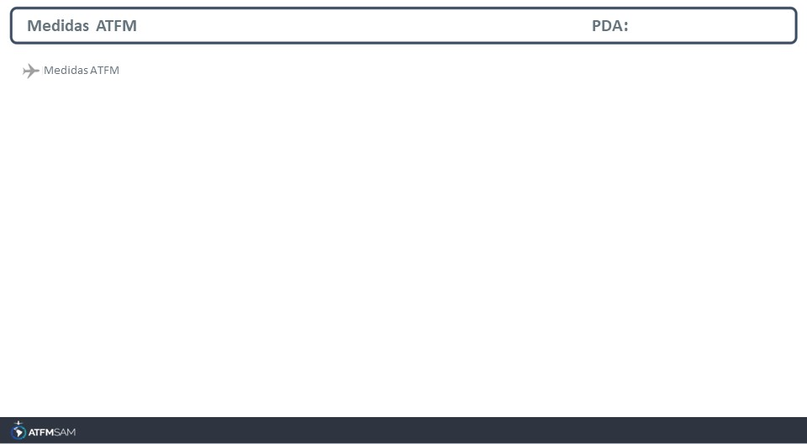
STATE | ORIGIN | DESTINY | ER | START | MEASURE | REASON

Slide 4
