Slide 1
PDA - CHILE 15/03/2025

Slide 2
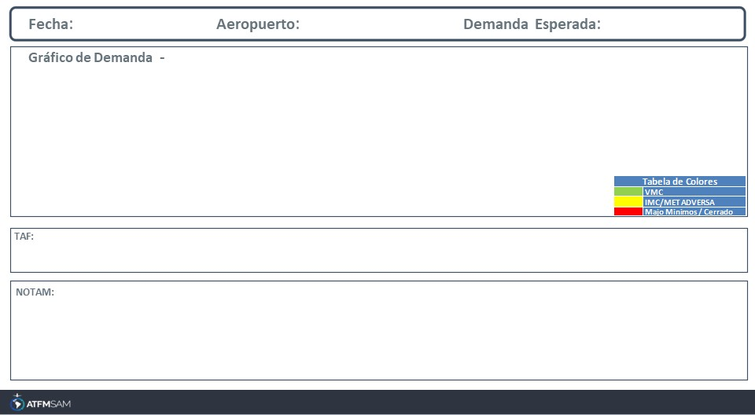
15/03/2025
SCDA
BAJA
Mañana | Tarde | Noche
TAF SCDA 141031Z 1412/1512 21004KT CAVOK TX25/1418Z TN19/1510Z BECMG 1414/1416 21014KT BECMG 1500/1502 21004KT

Slide 3
15/03/2025
SCEL
BAJA
Mañana | Tarde | Noche
TAF SCEL 141000Z 1412/1512 15010KT 4000 BR OVC003 TX30/1419Z TN12/1510Z BECMG 1412/1414 0800 BCFG OVC002 BECMG 1416/1418 21015KT CAVOK TEMPO 1418/1500 SCT070 SCT210

Slide 4
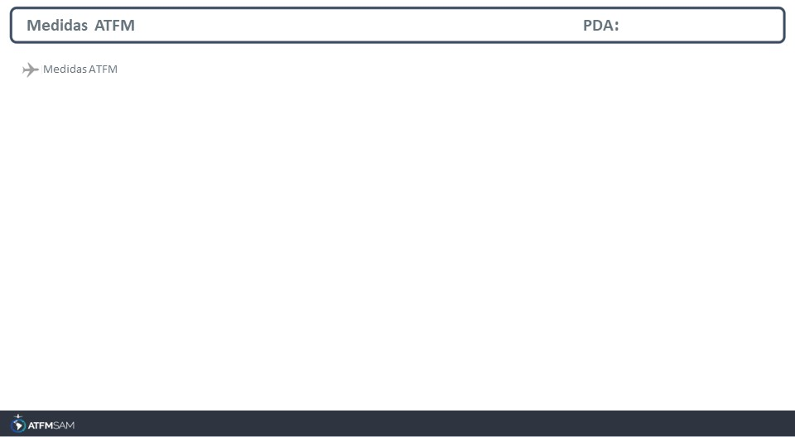
STATE | ORIGIN | DESTINY | ER | START | MEASURE | REASON

Slide 5
