Slide 1
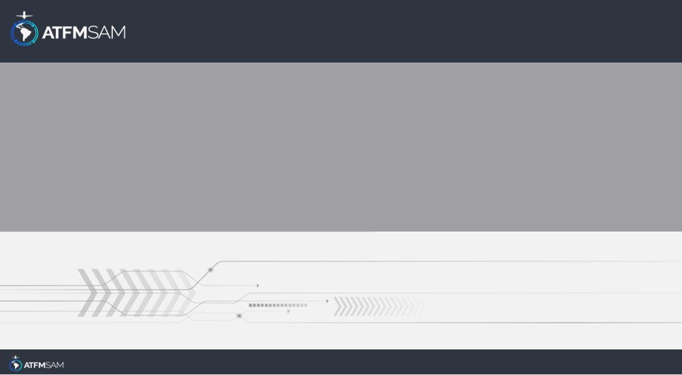
PDA - CHILE
18/06/2025

Slide 2
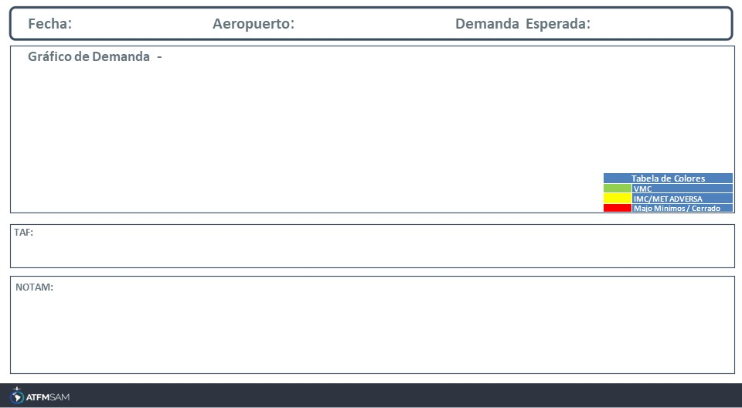
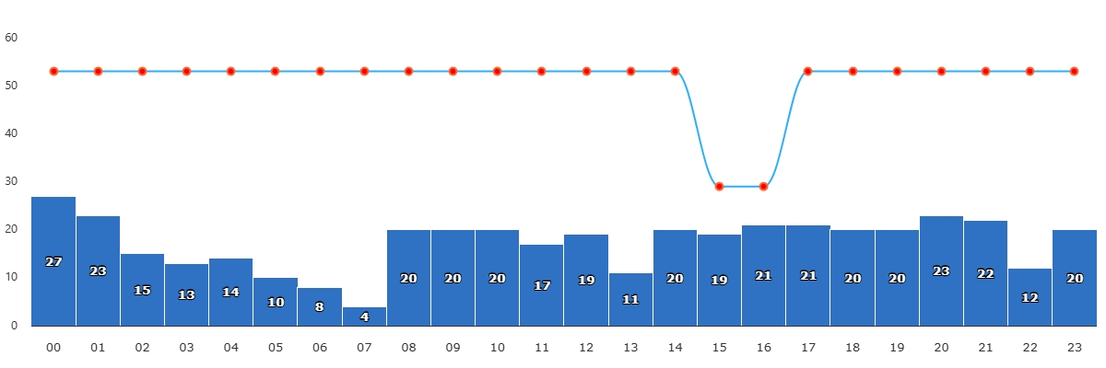
18/06/2025
SCEL
BAJA
Mañana | Tarde | Noche
TAF SCEL 171639Z 1718/1818 20008KT 9999 FEW080 SCT170 TX13/1719Z TN00/1810Z BECMG 1801/1803 15004KT CAVOK BECMG 1804/1806 VRB02KT 5000 BR TEMPO 1808/1812 2000 BECMG 1815/1817 8000 NSW NSC
SCEL - RWY 17R/35L CLSD, EXC LVP IS ACT CREATED: 28 May 2025 16:15:00 SOURCE: SCSCYNYX start: 2025-06-18T13:00:00.000Z - End: 2025-06-18T17:00:00.000Z

Slide 3
18/06/2025
SCEL
BAJA
Mañana | Tarde | Noche
TAF SCEL 171639Z 1718/1818 20008KT 9999 FEW080 SCT170 TX13/1719Z TN00/1810Z BECMG 1801/1803 15004KT CAVOK BECMG 1804/1806 VRB02KT 5000 BR TEMPO 1808/1812 2000 BECMG 1815/1817 8000 NSW NSC
SCEL - RWY 17R/35L CLSD, EXC LVP IS ACT CREATED: 28 May 2025 16:15:00 SOURCE: SCSCYNYX start: 2025-06-18T13:00:00.000Z - End: 2025-06-18T17:00:00.000Z

Slide 4
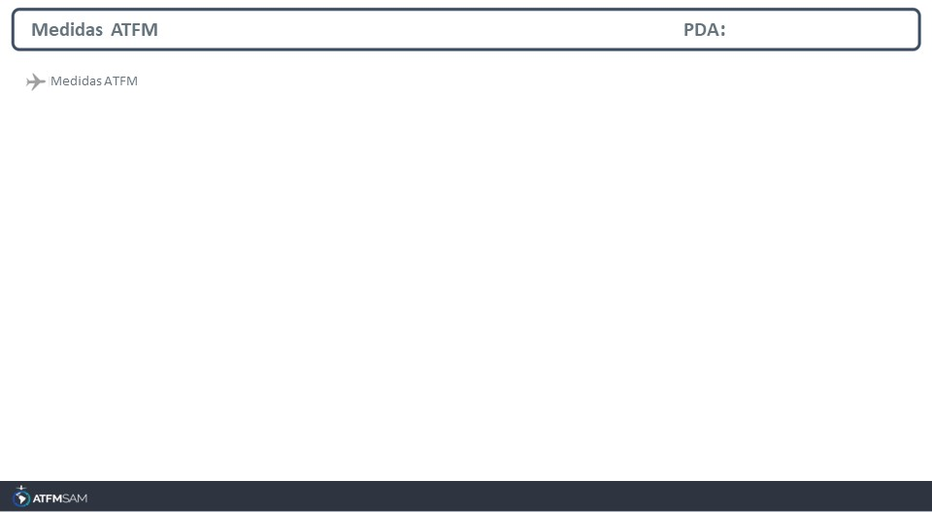
STATE | ORIGIN | DESTINY | ER | START | MEASURE | REASON
CHILE | SABE | SCEL | SCEL | 18/06/2025 - 15:30 | 00:03:00 | RESTRICCIONES DE RWY

Slide 5
