Slide 1
PDA - CHILE 24/07/2024

Slide 2
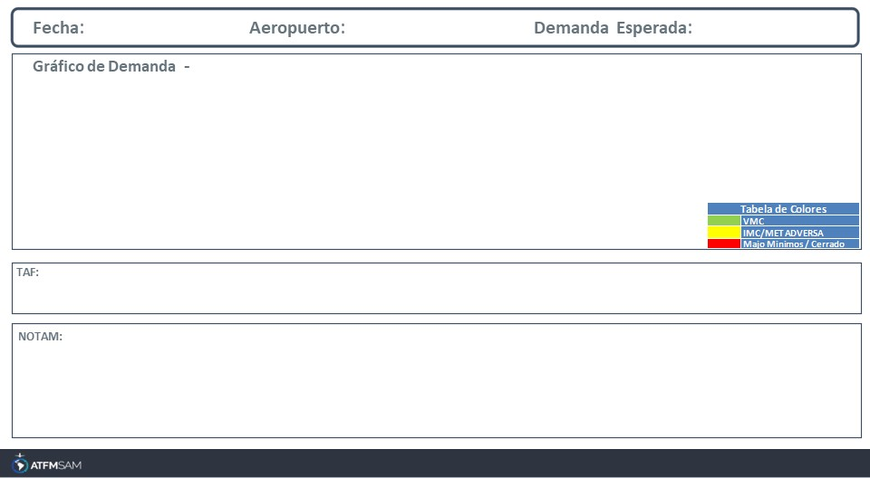
24/07/2024
SCEL
Baixa
Mañana | Tarde | Noche
TAF COR SCEL 231026Z 2312/2412 VRB02KT 2000 BR NSC TX13/2319Z TN01/ 2410Z TEMPO 2312/2315 0500 FG SCT002 BECMG 2315/2317 19010KT 8000 BECMG 2401/2403 15004KT TEMPO 2408/2412 5000 BR
SCEL - RWY 17L/35R INCREASED BIRD HAZARD (MODERATE TO SEVERE) start: 2024-04-25T16:16:00.000Z - End: 2024-07-26T12:30:00.000Z SCEL - POSS DELAY UPON ARRIVALS AND DEPARTURES DUE TO RWY USE RESTRICTIONS CREATED: 29 Apr 2024 18:30:00 SOURCE: SCSCYNYX start: 2024-04-30T00:00:00.000Z - End: 2024-07-29T23:59:00.000Z

Slide 3
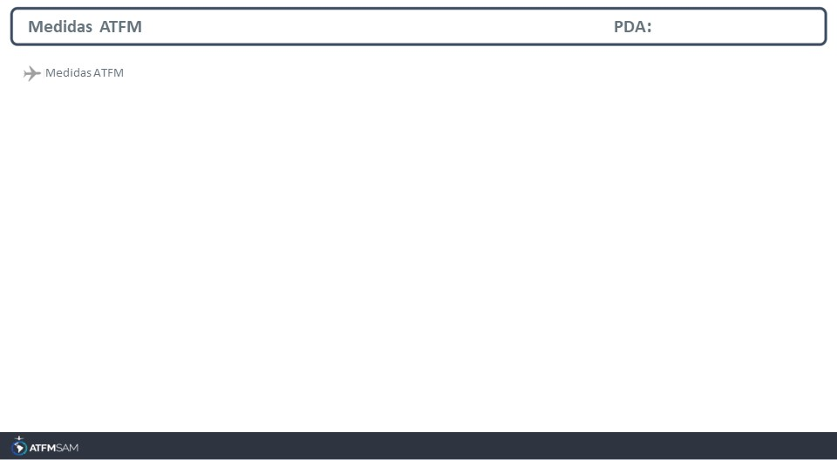
STATE | ORIGIN | DESTINY | ER | START | MEASURE | REASON

Slide 4
