Slide 1
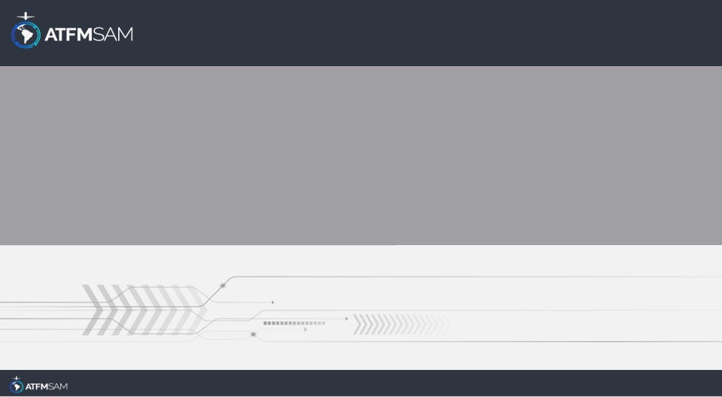
PDA - CHILE
26/07/2024

Slide 2
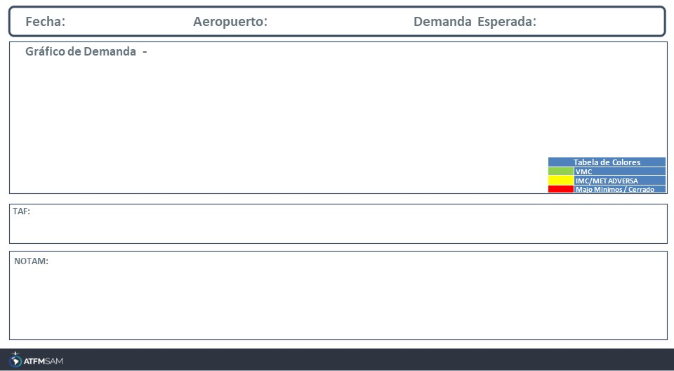
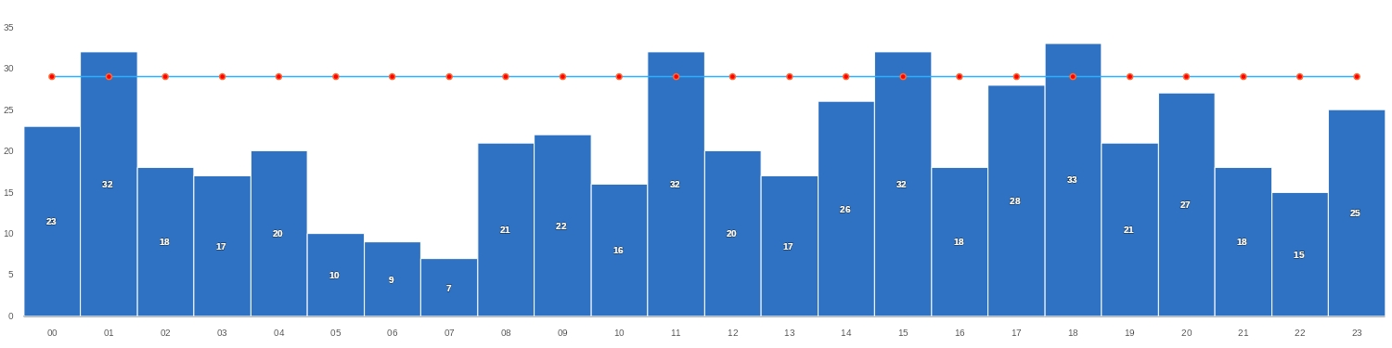
26/07/2024
SCEL
Baixa
Mañana | Tarde | Noche
TAF SCEL 251000Z 2512/2612 15004KT 8000 NSC TX18/2519Z TN04/2610Z TEMPO 2512/2514 VRB02KT 5000 HZ BECMG 2517/2519 18008KT TEMPO 2520/2600 SCT160 BECMG 2602/2604 30004KT 7000 BECMG 2604/2606 4000 BR TEMPO 2606/2612 VRB02KT 0500 FG SCT002
SCEL - POSS DELAY UPON ARRIVALS AND DEPARTURES DUE TO RWY USE RESTRICTIONS CREATED: 29 Apr 2024 18:30:00 SOURCE: SCSCYNYX start: 2024-04-30T00:00:00.000Z - End: 2024-07-29T23:59:00.000Z

Slide 3
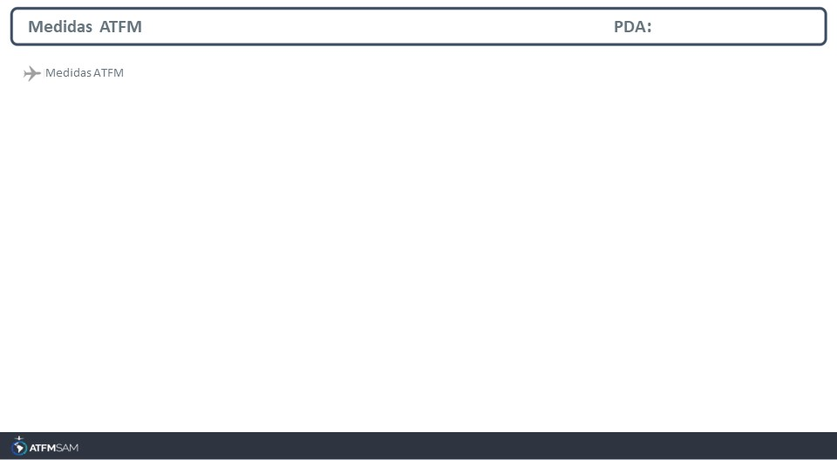
STATE | ORIGIN | DESTINY | ER | START | MEASURE | REASON

Slide 4
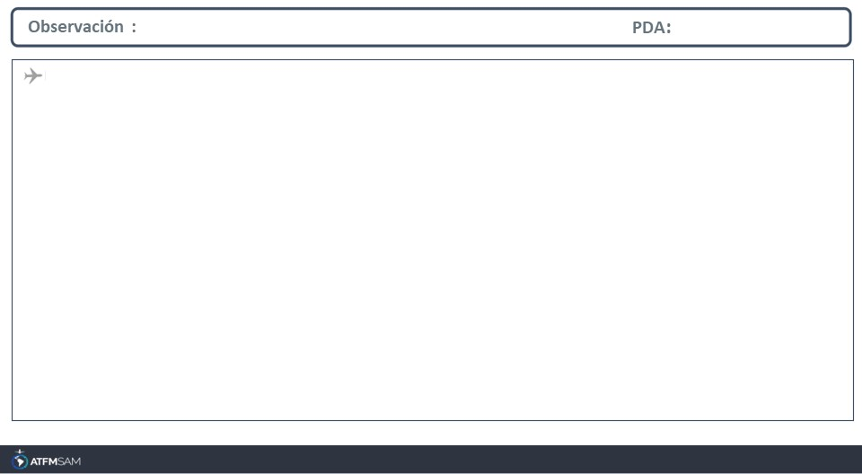
FMU-CHILE
Avda. San Pablo 8381, Pudahuel.
Santiago -Chile
EMAIL: fmu-chile@dgac.gob.cl
AMHS: SCLPATFM -SCLPFMUA
REDDIG ADM: 404034 -404793
REDDIG ATS: 4014
Tel: ( 56 2) 2 4392000 extensión 4034 - 4793

